Slide 1
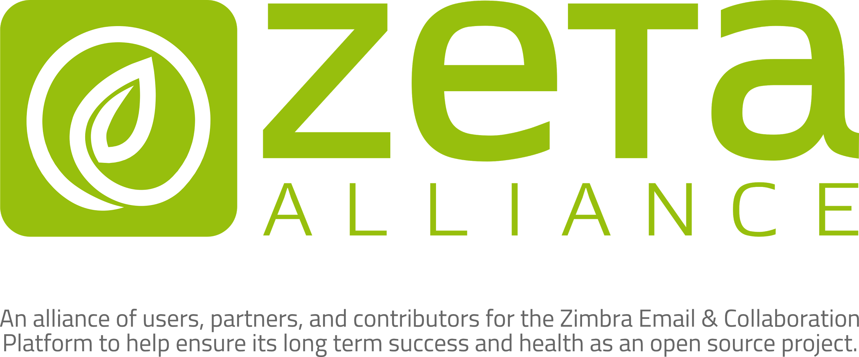

Slide 2

The Zeta Alliance: History [1]
Zetalliance.org domain and ZCS email server acquired: Nov, 2015
Public outreach for interest: Nov, 2015
Mailing lists set up in Dec, 2015 - devel@ and users@ used at this time.
http://lists.zetalliance.org/mailman/listinfo/
Weekly Thurs. conference call started in March, 2016 and have continued since.
https://www.freeconferencecall.com/wall/zetalliance#/history
Notes:
If more background is needed. Adam Cody [Ajcody], an ex-Zimbra Support staff member, in July 2015 was in discussions with Zextras to join their team and made a non-profit organization for Zimbra a condition of joining Zextras and that they would help with those efforts. Adam had helped start a Linux User Group in Madison, WI USA in the 90’s. Cine, support manager at Zextras and open source advocate as well, started brainstorming with Adam in August on how to start an alliance and what needs it intended fulfill. By November, they through they were ready to reach out to others in the community about their idea.

Slide 3
The Zeta Alliance: History [2]
Charter signed on March 16th, 2016 by
Guy Carrè
Filippo "Cine" Cinetto
Adam "ajcody" Cody
Phil Daws - Innovot
Barry "barrydg" de Graaff
Jorge "Jorge-zimb" de la Cruz
Silvan M. "pcdog" Gebhardt
Quanah Gibson-Mount
Tony "Tonster" Publiski
Bill "Phoenix" Pye
Paolo "Zeus" Storti
David "Klug" Tuitou
http://www.zetalliance.org/the-zeta-alliance-charter
http://www.zetalliance.org/organization-structure

Slide 4
The Zeta Alliance: Mission
To build an alliance of users, partners, and contributors for the ZCS platform to help ensure its long term success and health as a F/LOSS project.

Slide 5
The Zeta Alliance: Charter
To build a strong alliance and community that is either on equal footing or outside of the Zimbra Inc. business and is free of the fear of 'conflict of interests'.

Slide 6
The Zeta Alliance: Charter
That the alliances central goal is to promote and ensure the long term success and health of the ZCS project.

Slide 7
The Zeta Alliance: Charter
To be the cornerstone for ZCS knowledge and community support and development.

Slide 8
The Zeta Alliance: Charter
To be the cornerstone for commercial and noncommercial ZCS listing and announcements for support and services.
Notes:
We currently haven’t started this yet.

Slide 9
The Zeta Alliance: Charter
To advocate for true openness and direct contribution to the ZCS code base from the community at large.
Notes:
For example, https://goo.gl/xfjdmL , our “Problem-Recommendation-Benefit” document.

Slide 10
The Zeta Alliance: Charter
To advance the belief that cooperative competition is good for the whole community and will advance the stability and features of the ZCS platform.

Slide 11
The Zeta Alliance: Charter
To advocate for more modulations to the ZCS code base and proper licensing choices that allows for third party products and contributions to give the community more choices and freedom from vendor lock-in.

Slide 12
The Zeta Alliance: Charter
To advocate and expand the use of ZCS in general and in new markets or technologies as being the first choice solution.

Slide 13
The Zeta Alliance: Charter
To advocate and promote the ZCS community to be more involved in the underlying F/LOSS projects that ZCS is built upon and vice versa.

Slide 15
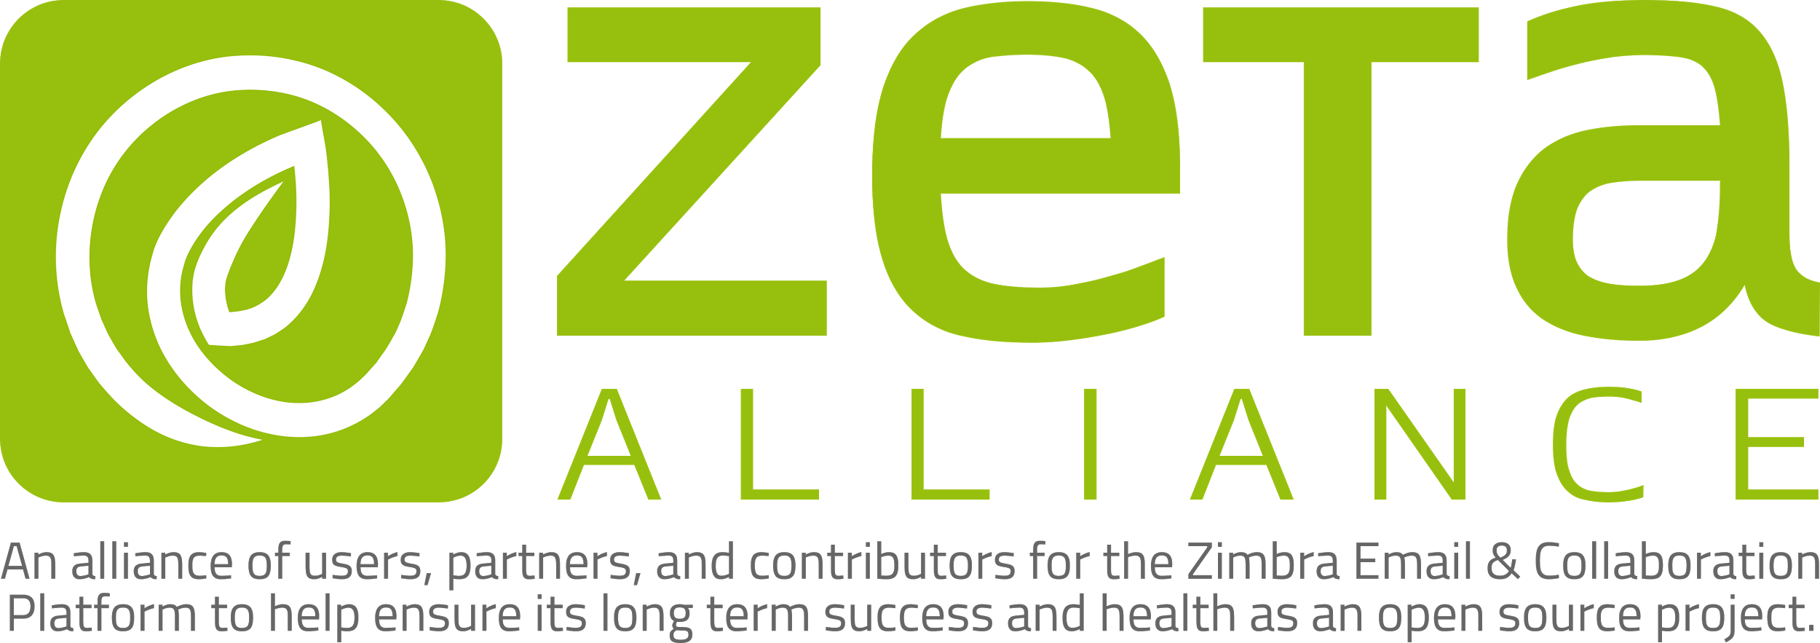

Slide 18


Slide 20


Slide 21


Slide 23


